Slide 1



CORPORATE PRESENTATION

Slide 2
ABOUT US
1
2
3
4
5
Leading
manufacturer of Exterior paints in India since five decades.
Special choice for engineers, builders, contractors and consumers alike.
Snowcem has emerged as the most trusted brand over time.
Snowcem has consistently delivered on their promise of long lasting protection combined with beauty season after season.
Now with high performing quality paints less is always more than enough.

Slide 3
THE BRAND
VISION
MISSION
VALUES
To be the change leaders and most trusted brand in the Paint Industry.
To be the best place to work for the new generation.
Continuous Innovation
Consistent Quality
Customer Satisfaction
Robust Backend
Strong Core Team
Integrity above all
Flawless Service
Transparent Ecosystem

Slide 4



ECO FRIENDLY PAINTS
At Snowcem, we are environment friendly and believe in nurturing the ecosystem. Thus we thoroughly promote non-polluting water based paints. We care for the eco-system for which we have a highly advanced system for the treatment of factory effluents. Our main thought behind this is to leave the natural resources unharmed for our coming generation. Health & Safety of the employees, customers, environment and the planet is of top priority to us.

Slide 5
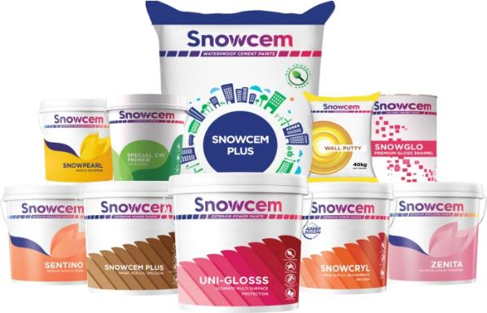
WHY SNOWCEM?
Most Trusted Brand among consumers and painters
We are One Stop – Shop Solution for paints
Uncompromised Quality = True Value for Money
Pioneer of Eco-friendly paints in India
Pan India availability and Great aftersales service
24 x 7 Technical Assistance Service

Slide 6

PAN INDIA PRESENCE
DELHI
KOLKATA
MUMBAI
Head Office
Zonal Office
and 37 depots
Branch Office
CHENNAI

Slide 7
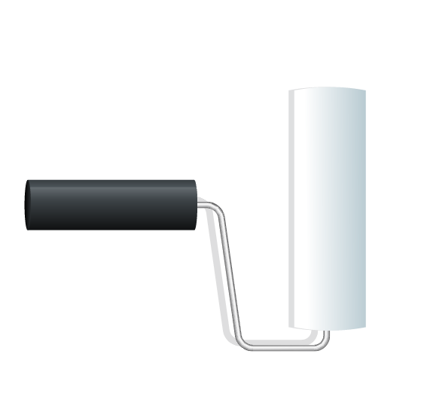

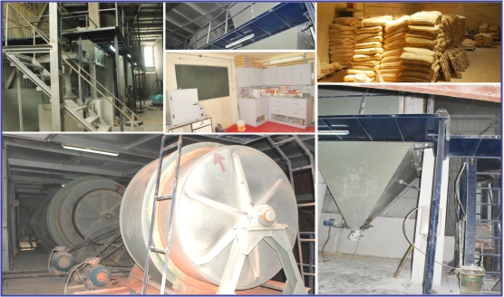
MANUFACTURING UNITS
Khardah, West Bengal
Sinnar, Maharashtra
Gotan, Rajasthan
Gumudipundi, Tamil Nadu

Slide 8

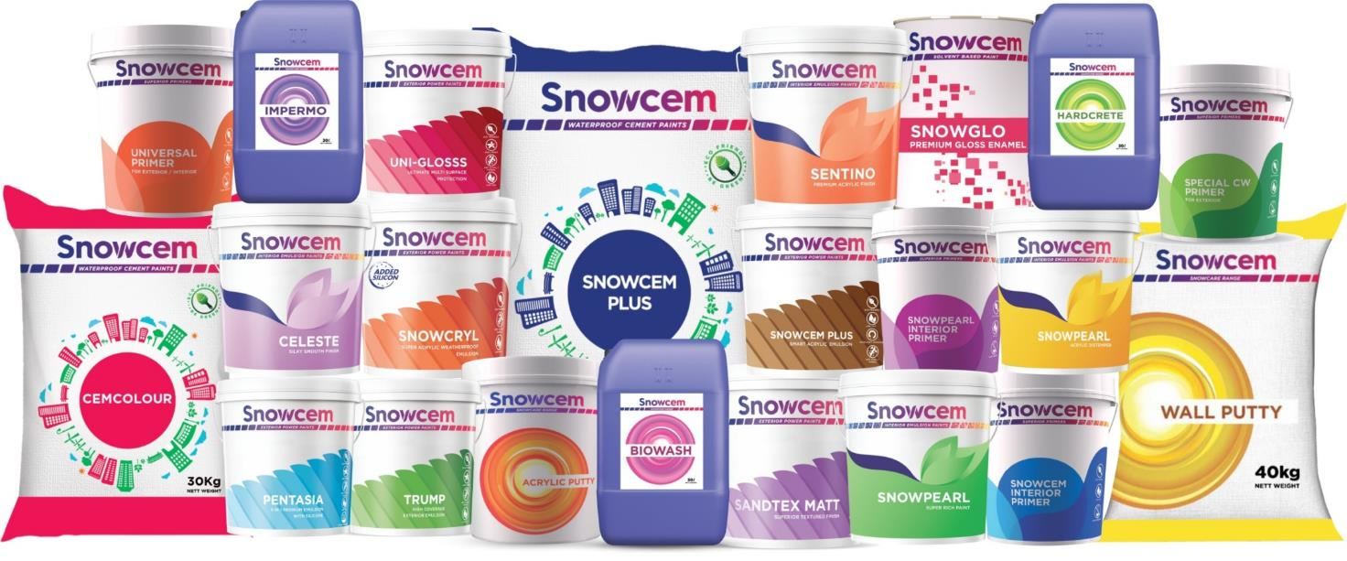
PRODUCT RANGE
PRODUCT RANGE

Slide 9
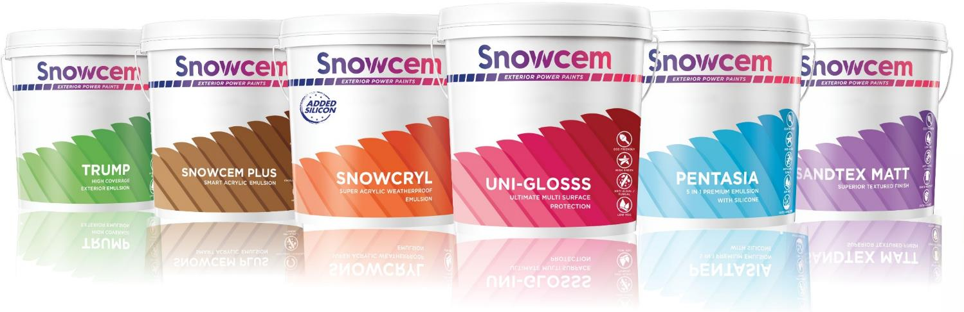
1. EXTERIOR POWER PAINTS
1. EXTERIOR POWER PAINTS

Slide 10
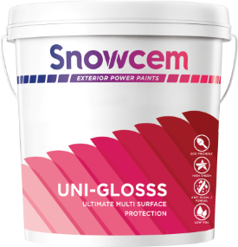
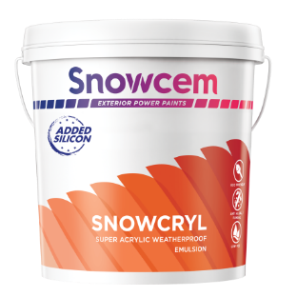
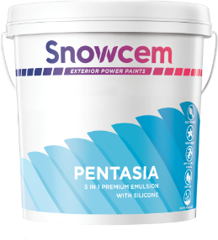

EXTERIOR POWER PAINTS
Unique formulation
High gloss finish
Anti Algae / Anti Fungal
Ecofriendly water based enamels
9 to 10 years of life
Dirt pick up resistant
Water repellent
Exceptional UV resistant
High sheen
Anti algal – anti fungal
100% Acrylic emulsion with Silicon additive
Superior color retention
Anti algal/fungal
Strong UV resistance
4 to 5 years of life

Slide 11
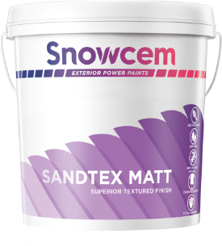
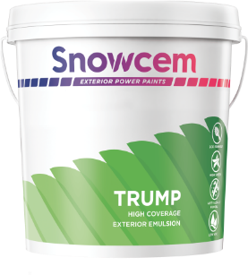
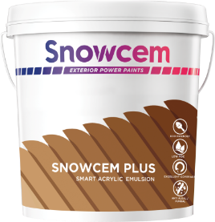

EXTERIOR POWER PAINTS
Bridges hairline cracks
Coating with extra thickness
Highly optimum with surface protection
Antialgal and antifungal
Upto 7 years of life
High opacity
Acrylic paint system
High coverage
Anti algal – anti fungal
4 to 5 years of life
Value for money
Highly optimum with surface protection
Can be used for interiors also
Anti algal / fungal
Soft Sheen

Slide 12
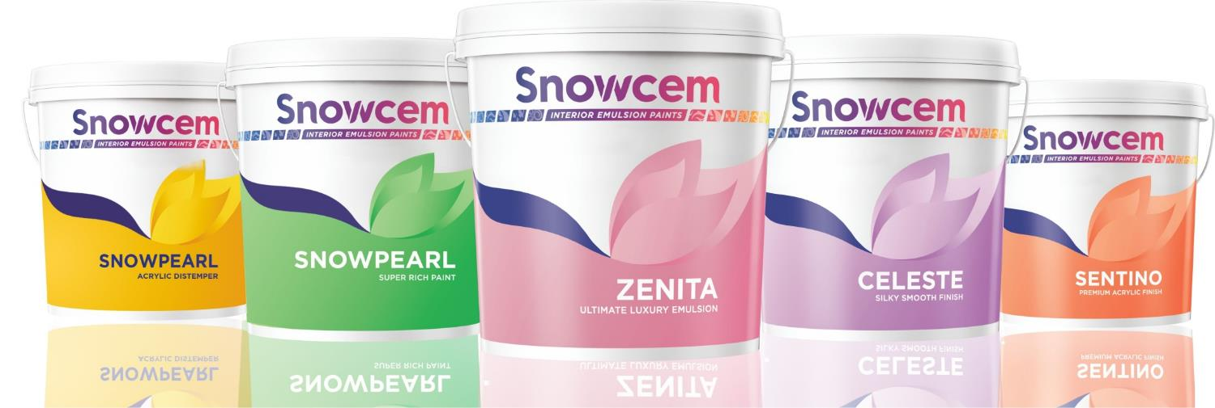
2. INTERIOR EMULSION PAINTS
2. INTERIOR EMULSION PAINTS

Slide 13
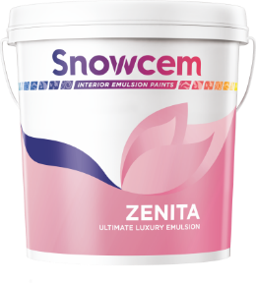
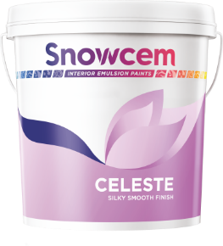
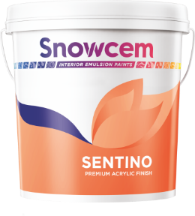

INTERIOR EMULSION
Excellent anti graffiti effect
Durable semi glossy finish
Long lasting semi gloss
Good washability
Fungai- algae resistant
No added heavy metals like lead, chromium
Premium quality luxury emulsion
Durable and appealing rich finish
Strong adhesion properties
Long lasting sheen
Good washability
Non yellowing properties
Fungai- algae resistant
No added heavy metals like lead, chromium
Durable and pleasant finish
Strong adhesion properties
Excellent flow and leveling
Good washability
Fungai- algae resistant
No added heavy metals like lead, chromium
Imparts a beautiful soft sheen

Slide 14
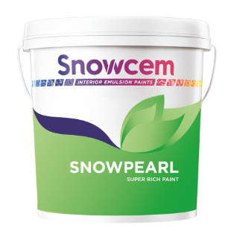
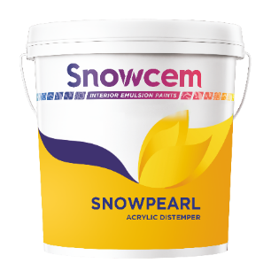
INTERIOR EMULSION
Durable and appealing finish
Excellent performance at optimum price
Hasle free application
Fast drying and quick recoatable
No added heavy metals like lead, chromium
3 to 4 years of life
Excellent whiteness and smoothness
Excellent performance at optimum price
It can be diluted with water
Fungai - algae resistant
Fast drying and quick recoatable
No added heavy metals like lead, chromium

Slide 15
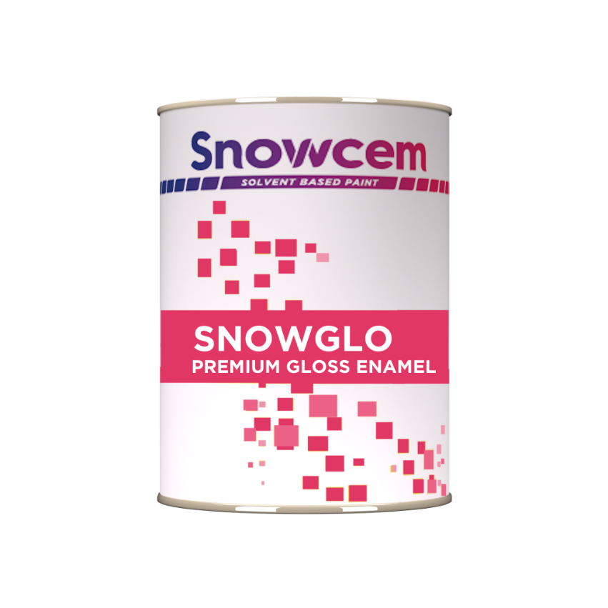
3. ENAMELS
3. ENAMELS

Slide 16
ENAMEL
Excellent consistency
Effortless Workability
Superior adhesion
High gloss
Ideal for outdoor & indoor application
Widest shade range

Slide 17
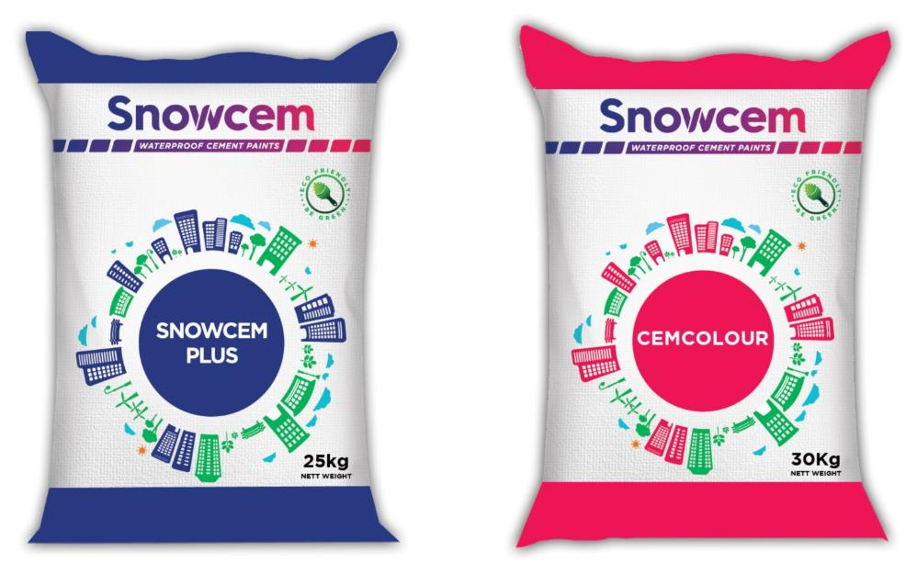
4. CEMENT PAINTS
4. CEMENT PAINTS

Slide 18

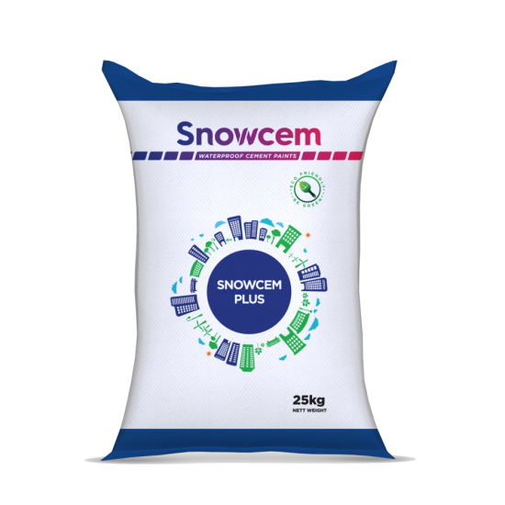
CEMENT PAINTS
High strength
Breathable paint
Superior brushability
Reflects heat
No Chalking
Fine powder form
White Portland cement and other additives
Available in many attractive shades
Beautiful matt finish
Application either to be brushed or sprayed
1st and 2nd coat should be cured properly
Drying time 6-8 hours depending on climatic conditions
Recoat 12-18 hours depending on climatic conditions
2 years of life
50-60 microns DFT
Environment friendly waterprofing cement paints

Slide 19
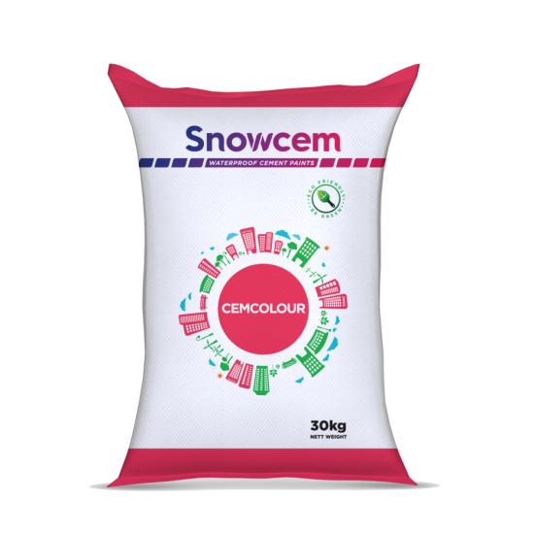
CEMENT PAINTS
Economy colour coating
Does not peel off or flake
Breathable paint
Becomes an integral part of plaster
Fine powder form
Portland cement and other additives
Available in many attractive shades
No curing
Good matt finish
Application by brush or spray
1st and 2nd coat should be cured properly
Drying time 6-8 hours depending on climatic conditions
Recoat 12-18 hours depending on climatic conditions
2 years of life
50-60 microns DFT
Environment friendly waterprofing cement paints

Slide 20
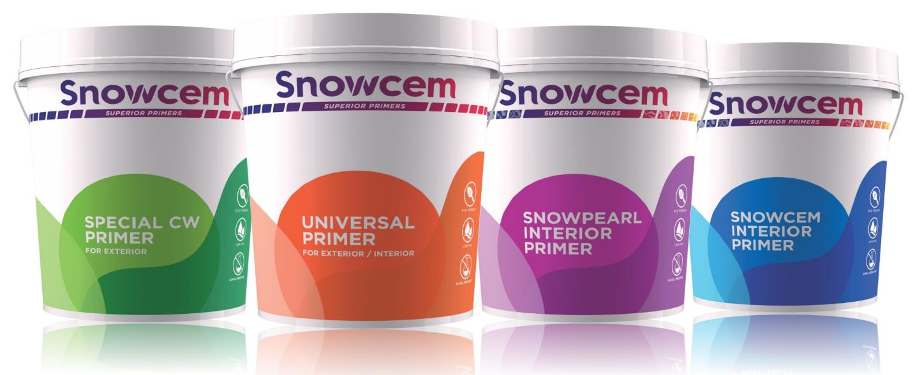
5. PRIMERS
5. PRIMERS

Slide 21
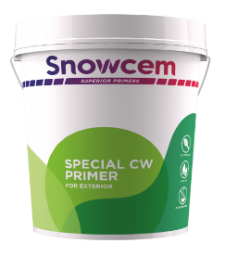
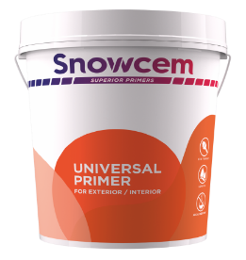

PRIMERS
Provides excellent adhesion to top coat emulsion
Excellent alkali resistant property
Improves appearance of top coat
Excellent opacity and whiteness
Prevent peeling off of top coat emulsions
No added heavy metals like lead and chromium
Improve appearance of top coat
Excellent opacity and whiteness
Prevent peeling off of top coat emulsions
Fast drying and quick recoatable
Provide excellent adhesion to top coat emulsion
N0 added heavy metals like lead and chromium

Slide 22
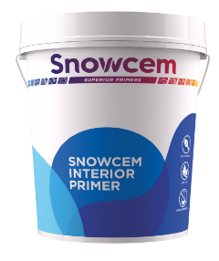
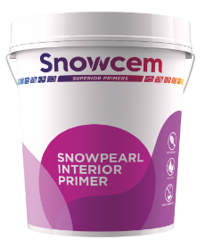
PRIMERS
Alkali resistance
Easy brushing and excellent covering
Quick drying and good sealing properties
Excellent opacity and whiteness
No added heavy metals like lead and chromium
Alkali resistance
Easy brushing and excellent covering
Quick drying and good sealing properties
Excellent opacity and whiteness
No added heavy metals like lead and chromium

Slide 23
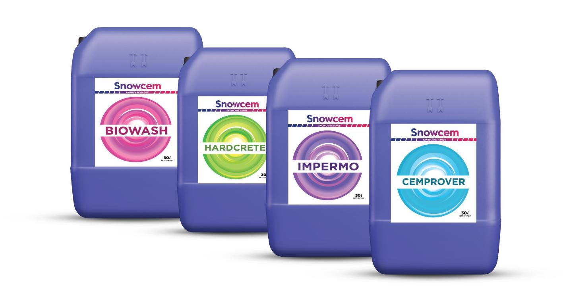
6. SNOWCARE RANGE
6. SNOWCARE RANGE

Slide 24
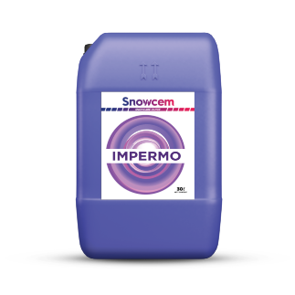
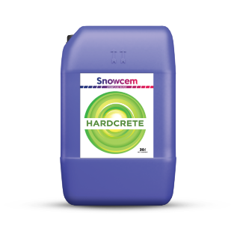
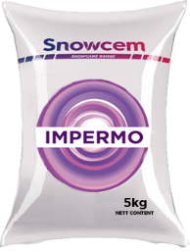
SNOWCARE RANGE
Waterproof mass concrete
Cement sand renderings
Fine powder/dark brown liquid
More than 80% reduction in permeability
1kg of powder or 200 ml of liquid to every 50kg of cement
Chloride free, most dependable & economical in the long run
Gives extra hardness to the surface
Roof toppings
2 years of life
Waterproof mass concrete
Cement sand renderings
Floor toppings
Keeps reducing with the increase in quantity of HARDCRETE
Hardens mass concrete
Liquid
70% to 80% reduction in permeability
Increases with increase in quantity of HARDCRETE
2 years of life

Slide 25
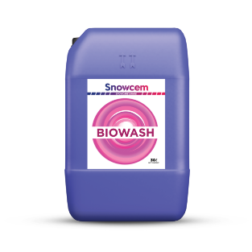
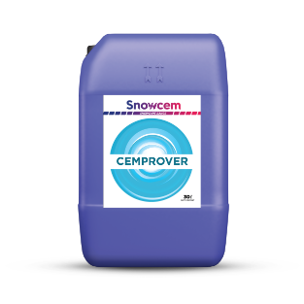
SNOWCARE RANGE
Anti fungal - Anti algae
Clear liquid
Water
Slight reddish
Smooth and consistent
By brush preferably or by spray gun
Approx 1 hour depending on climatic conditions
24 hours for recoating if required
2 years of life
Liquid
Colour milky white
Drying time 6-8 hours depending on climatic conditions
Dilution ratio 1:1 primer : clean water
Approx covering capacity
Thin with water
24 hours for recoating if required
By brush preferably or by spray gun
2 years of life

Slide 26
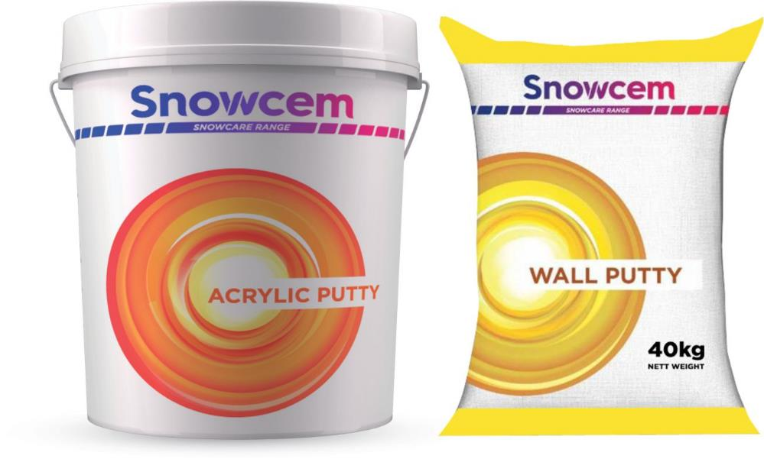
7. SNOWCARE WALL PUTTY
7. SNOWCARE WALL PUTTY

Slide 27
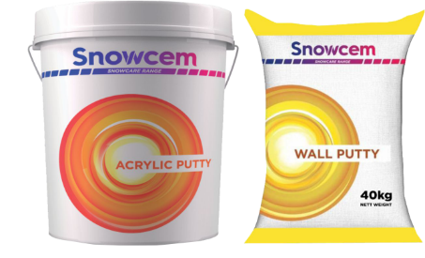


SNOWCARE WALL PUTTY
Fills hair cracks and pin holes
Water repellent
Needs no curing
Gives toughness to the surface
Non toxic and non inflammable
Excellent consistency
Effortless workability
Superior adhesion
Excellent whiteness
Smooth and durable surface preparation

Slide 28

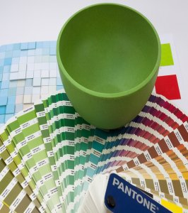
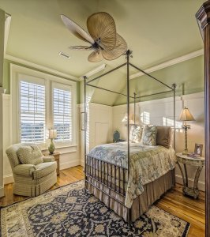
OUR SERVICES
OUR SERVICES (Available on our website)

Slide 29




SERVICES
KNOW YOUR COLOR
Vastu plays an integral role in your day to day life. Know what color suits your personality and home best.
VISUALIZER
Check out and choose the best color combinations that will beautify your walls best with our unique Visualizer.
BUDGET CALCULATOR
Calculating budget can be tedious and exhausting. With our automatic budget calculator, there is nothing
more to worry about. The math is not a problem anymore.

Slide 30










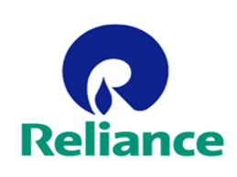



PRESTIGIOUS CLIENTS

Slide 31


THANK YOU

